Slide 1
Predicting Time until Discharge Following Kidney Donation
By: Stewart Hagen
HDS 5101 – Predictive Modeling

Slide 2
Dataset and Data Cleaning
9049 observations of 1297 variables
Population: kidney donors at three medical sites at the University of Birmingham, Alabama; the University of Minnesota; or the Mayo Clinic between August 2007 and June 2011
98 Subjects did not have any data, and were removed
A further 41 were removed for lacking subject ID, discharge date, or outlier values
Total number following these removals: 8713
From the 1297 variables, only 12 were chosen for analysis
Facility ID, Subject ID, Weight + Units, Height + Units, History of Alcoholism, History of Illicit Drug Usage, History of Tobacco Usage, Chronic Pain, and Time until Discharge Post Donation

Slide 3
Data Wrangling
Necessary Changes Made to the Data:
Removed those who only had a subject ID
Removed those who did not have a subject ID
Changed 998 values (chose not to respond) to NA values
Changed categorical variables to factors
Changed Date of Birth to Age
Standardized Height and Weight to one unit (Kg and cm)
Removed units for height and weight
Classified patients with outcomes over 100 as outliers (12 patients)

Slide 4
Summary Statistics
Mean and Standard Deviations of Each Continuous Variable:
Weight: 76.9 Kg (16.35)
Height: 170 cm (9.77)
Age: 39.7 years (11.46)
Days until Discharge: 4.29 days (2.72)
Proportions of each Categorical Variable:
History of Drug Usage: .05 (Yes), .95 (No)
History of Alcoholism: .04 (Yes), .96 (No)
Chronic Pain: .90 (Never), .03 (Previous), .07 (Current)
History of Tobacco: .331 (Current), .152 (Previous), .52 (Never)
Facility ID: .27 (ID = 8128), .31 (ID = 8131), .42 (ID = 8201)

Slide 5
Missing Data
7507 of the 8713 patients had complete data for the selected predictor variables
The most common missing variables were History of Drug Usage, History of Alcoholism, and Chronic Pain
Additionally, the least common variables with missing data (that weren’t pre-selected to be complete) were Weight and Height
The most common pattern was just Drug Usage, followed by just Chronic Pain and all three history variables
In total about 2% of the data was missing following data cleanup

Slide 6
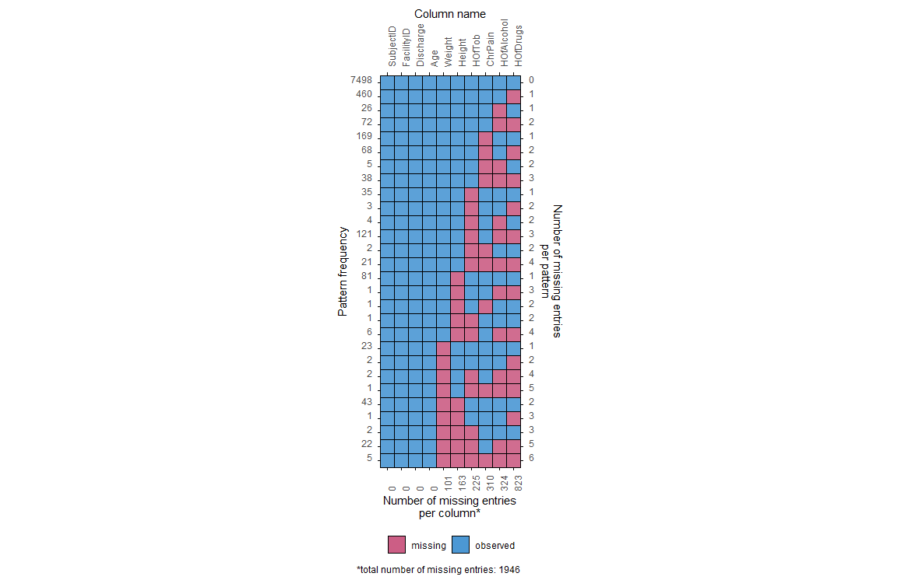
Missing Data

Slide 7
Missing Data in Training Data
880 of 1000 selected patients had complete profiles
The exact same three variables and patterns from the whole dataset were most common
202/10000 total entries were missing, matching the overall dataset

Slide 8
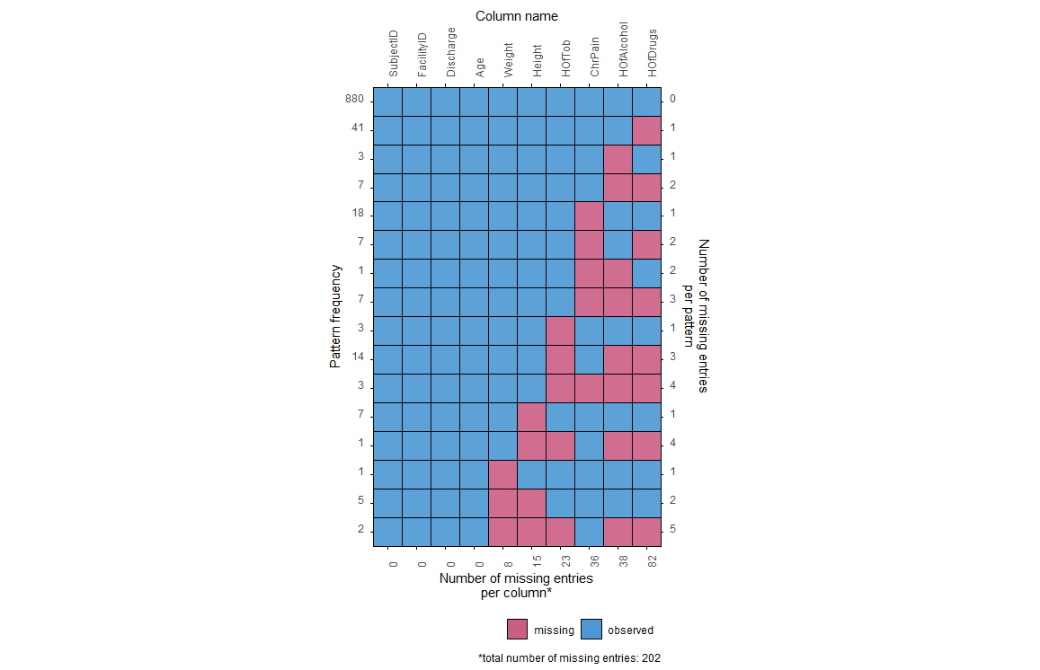
Missing Data in Training Data

Slide 9
Imputation
Multiple imputations were performed
10 imputations with 10 iterations were done
This imputed dataset was used for the next four models

Slide 10
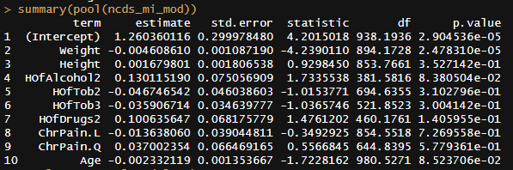
Log-Linear Model

Slide 11
Log-Linear Model
Log-Linear was chosen to keep values positive and continuous
Significant predictors at the .05 level were the intercept and Weight
Significant predictors at the .10 level were History of Alcohol and Age
The predicted mean number of days until discharge was 3.74
The MSE was 7.81

Slide 12
Single Tree Model
Formula: Discharge ~ .
Most variables were discarded
The variables that were used to make the tree were Facility ID, Age, and Weight
The tree had 5 terminal nodes, and the range of predicted values was (2.67, 7.20)
The mean predicted value was 4.11 and the MSE was 7.81

Slide 13
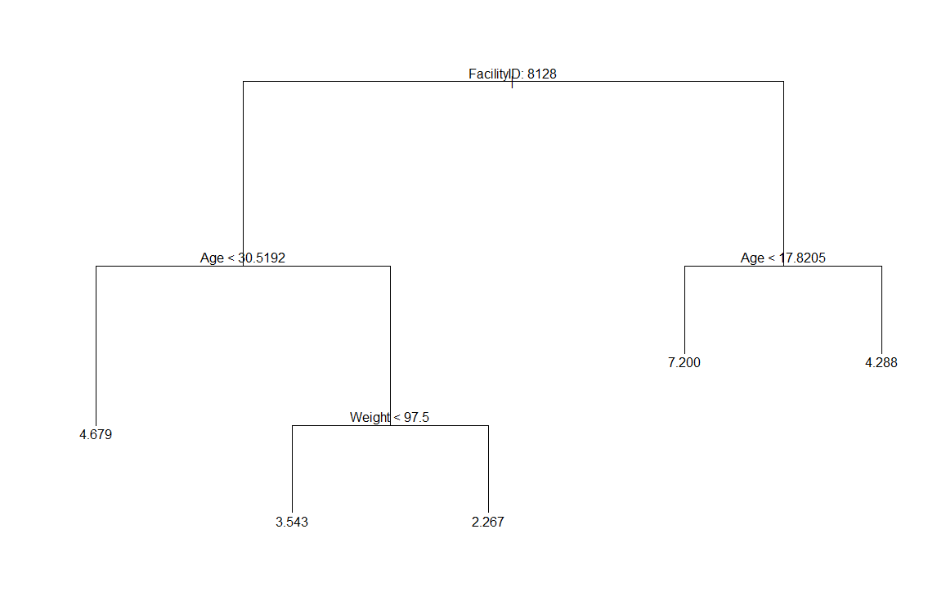
Single Tree Model

Slide 14
Random Forest
Formula: Discharge ~ .
Number of trees: 1000
The mean prediction value was 3.30, which was notably lower than the other models, and the MSE was 7.76
This model deviated from the mean of the training set the most (by almost 1 whole day)

Slide 15
Lasso Model
Formula: Discharge ~ FacilityID + Weight + Height + HOfAlcohol + HOfTob + HOfDrugs + ChrPain + Age
The optimal lambda value using CV methodology was .424
The mean was 4.12 and the MSE was 6.69, the lowest of all the models

Slide 16
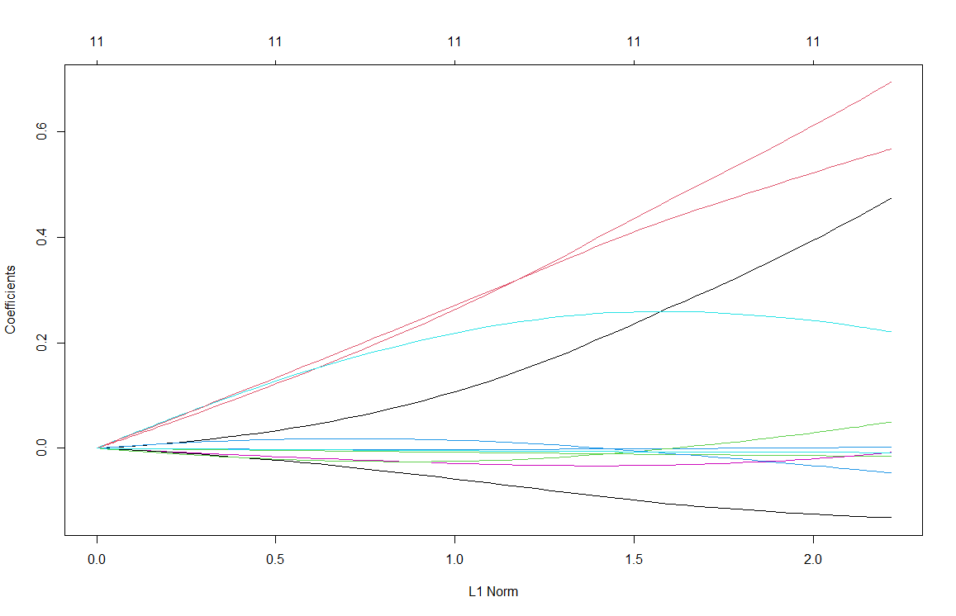
Lasso Model

Slide 17
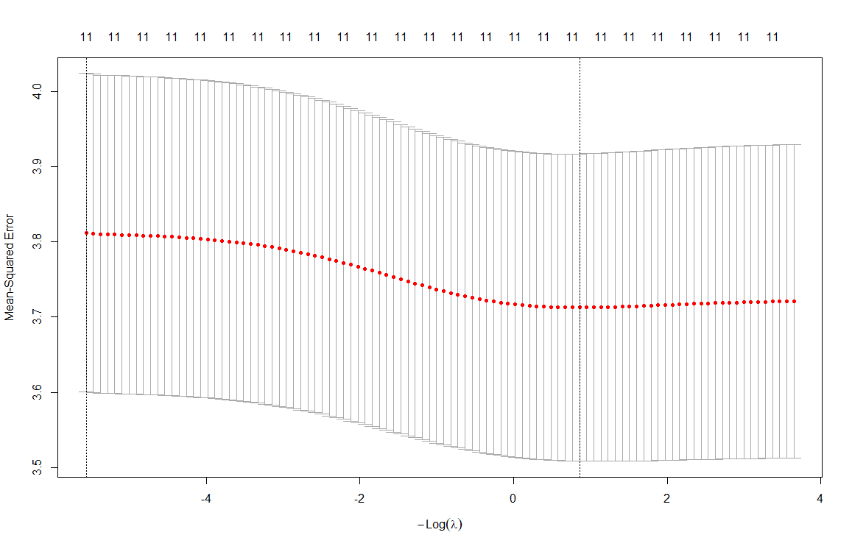
Lasso Model

Slide 18
Final Comparison
Model Name | Mean | MSE
Single Tree | 4.11 | 7.81
Random Forest | 3.30 | 7.76
Log Linear | 3.74 | 7.81
Lasso | 4.12 | 6.69

Slide 19
Final Remarks
No model performed exceptionally well, but the lasso model had the lowest error
Most predictor variables seemed to be insignificant
No accounting for complications during the surgery
Lasso removed the NA values from the analysis, likely leading to higher performance
The original dataset had many missing values, which could lead to higher variance in the predictions

Slide 20
Github
Link: https://github.com/SAHagen/HDS5101

